Slide 1
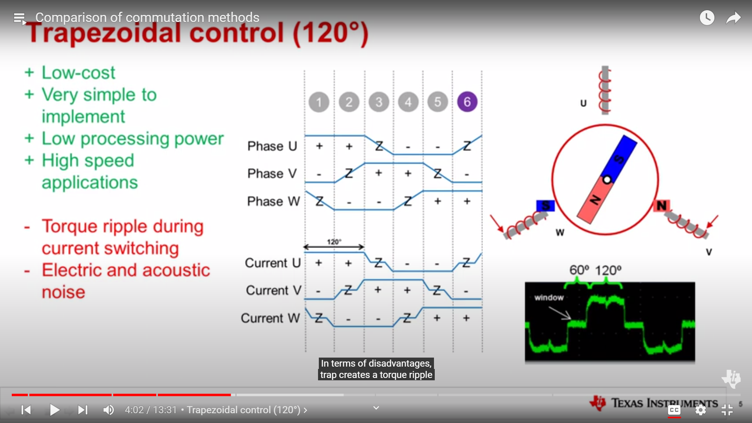
TRAP 120

Slide 2
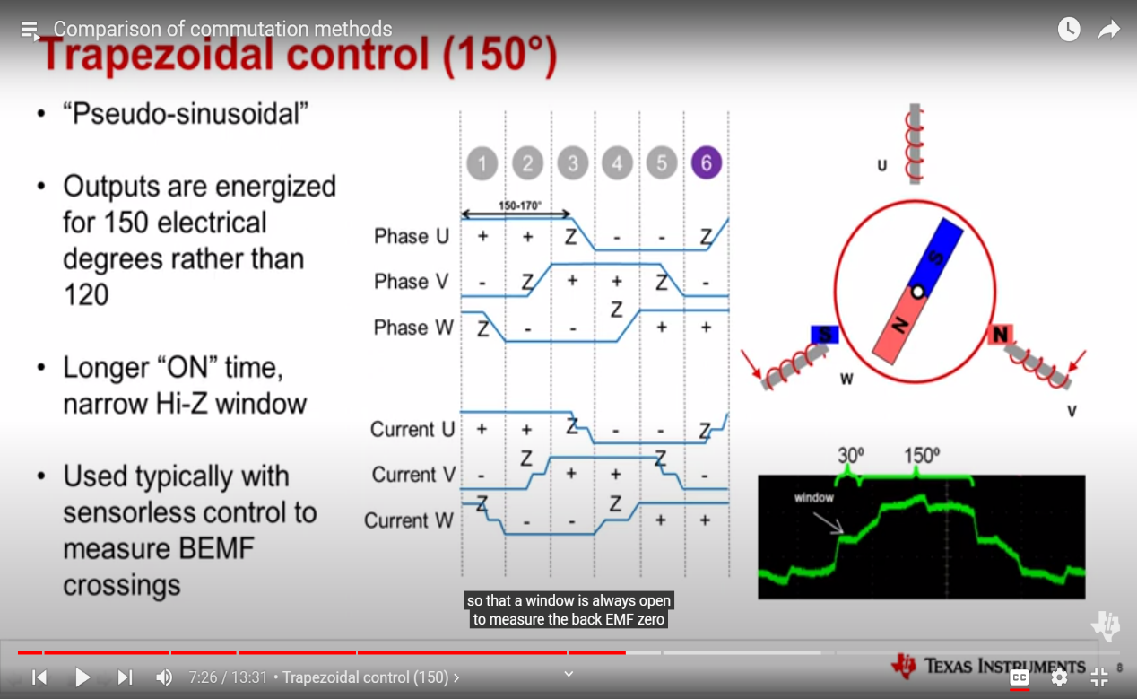
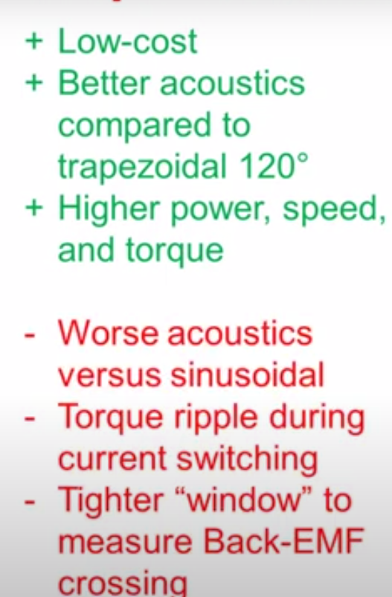
TRAP 150

Slide 3
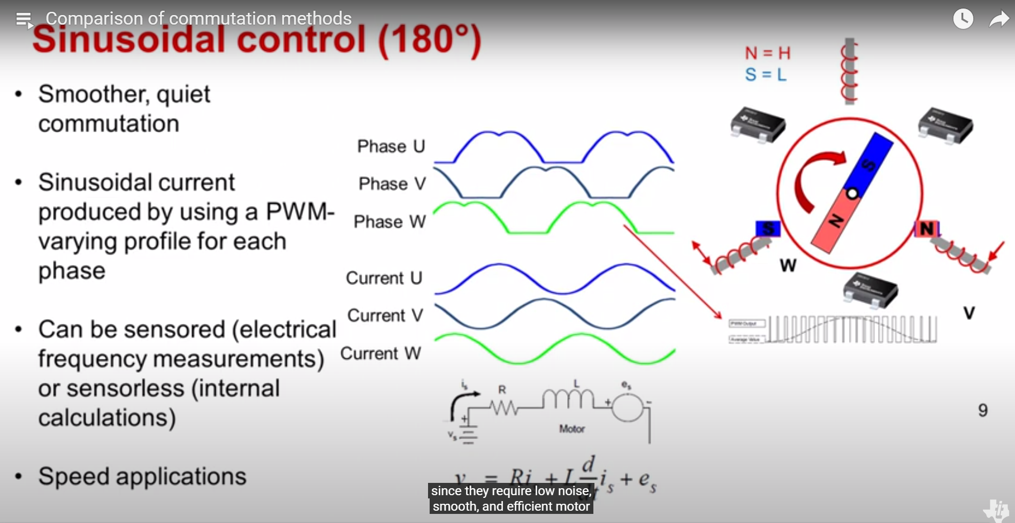
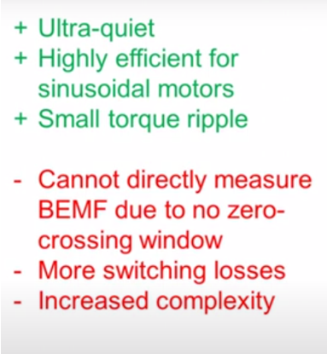
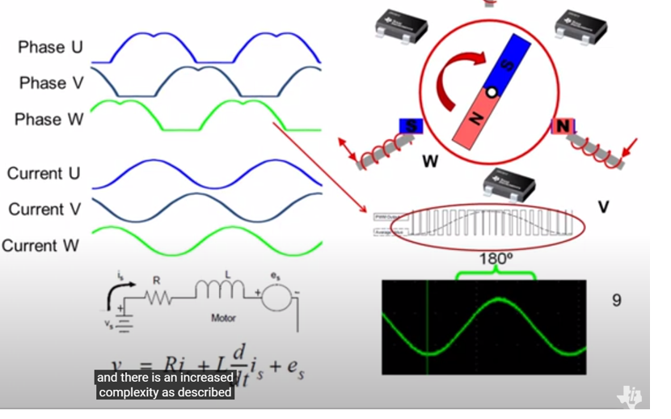
SINE 180
To produce the sine wave form in phase current the macdonald phase voltage wave form is given , It can be generated with help of PWM in motor phases.
Sensorless sinusoidal control is obtained by calculating the back emf generated in motor it can be achieved by calculating the back emf in 1st order eqn as shown in fig.

Slide 4
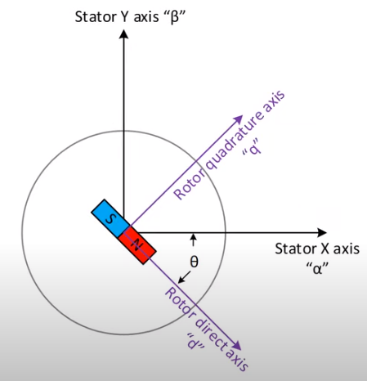
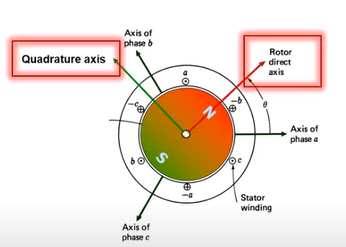
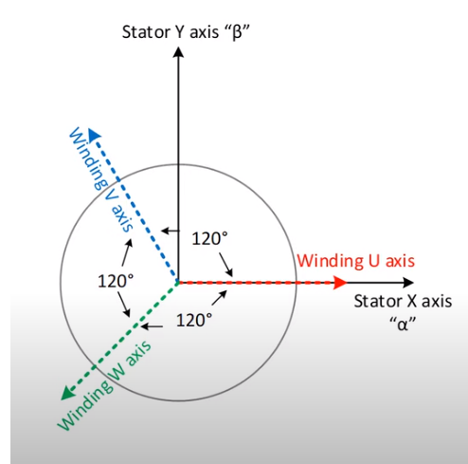
FOC
SEE IN NOTES

Slide 5
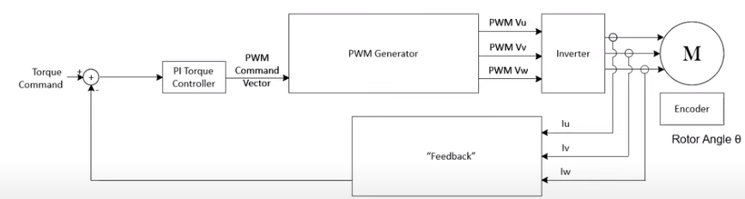
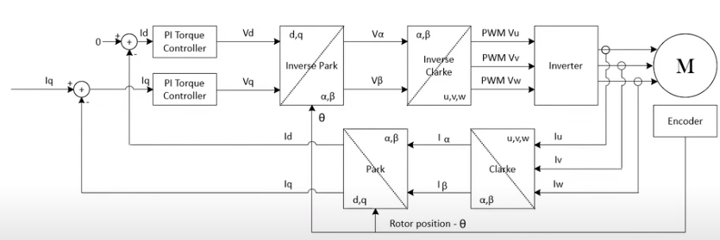
FOC CONTROL BLOCK DIAGRAM

Slide 6
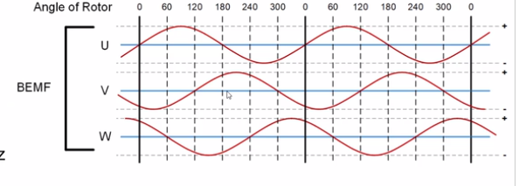
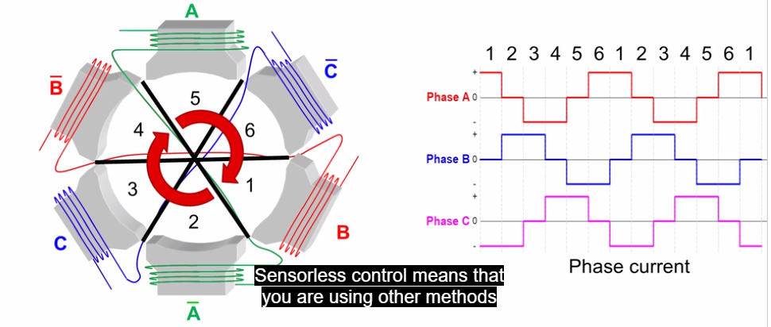
Sensorless control
BACK EMF
POSITION CONTROL – SENSORED CONTROL IS ADVISABLE SPEED CONTROL & TORQUE CONTROL – SENSORLESS CAN GIVE PRECISE CONTROL

Slide 7
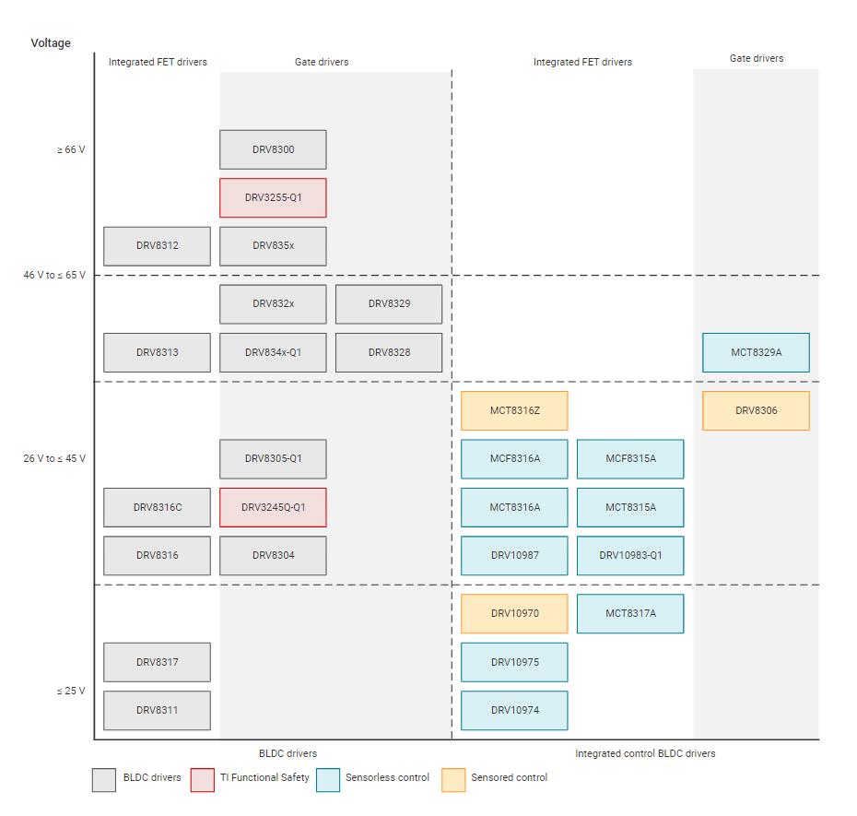
Options for motor driver

Slide 8
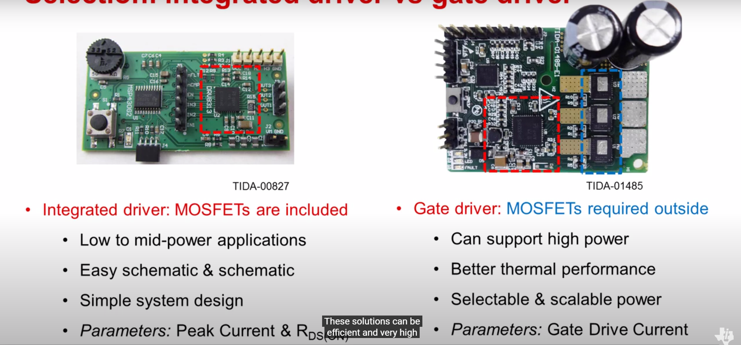
GATE V/S INTEGRATED FET DRIVERS

